Slide 1

Klean Soft Company
Directors
Beth &James

Slide 2
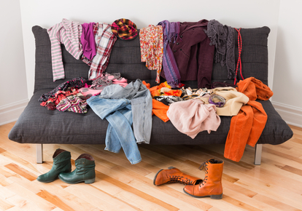
Opportunity
Giving laundry solutions to Nairobi residents

Slide 3

Opportunity
Giving laundry solutions to busy mom

Slide 4
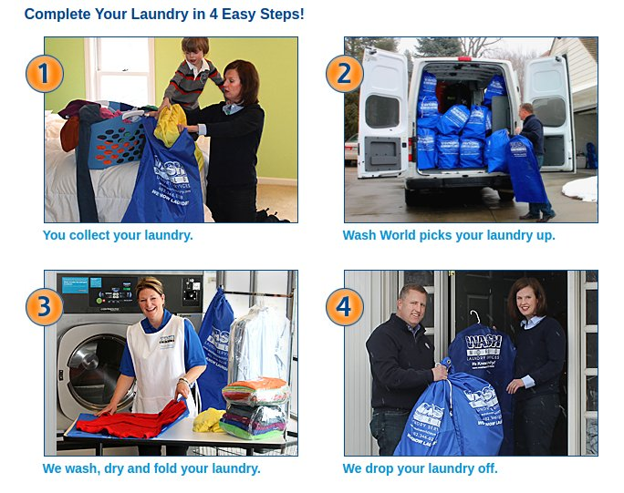
Why us?

Slide 5
Target clientèle
Nairobi residents
Coverage area.
Kilimani
Lavington
Runda
Kitusuru

Slide 6
Marketing Strategies
Word of mouth
Fliers and brochures
Billboards in the target areas

Slide 7
Competition
Mama nguo
Laundromats

Slide 8
Team
2 Co-founders
1 marketer
1 Driver
2 Collectors/ Delivery guys
3 Cleaning assistants

Slide 9
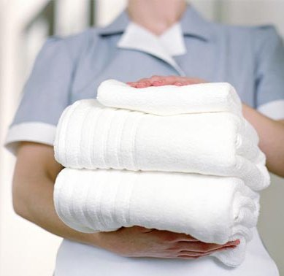
try out our service

